Slide 1
Cellular Mobile Communication

Slide 2
A general WLL setup

Slide 3
WHAT IS A CELL?
Dividing the coverage area into small segments, called cells.
Each cell uses a certain number of the available channels and a group of adjacent cells together use all the available channels. Such a group is called a cluster.
This cluster can repeat itself and hence the same set of channels can be used again and again.
Each cell has a low power transmitter with a coverage area equal to the area of the cell.
This technique of substituting a single high powered transmitter by several low powered transmitters to support many users is the backbone of the cellular concept.

Slide 4
Cellular concept
Developed by Bell labs 1960’s- 70’s.
Areas divided into cells.
The cell is served by a base station with lower power transmitter.
Each cell gets portion of total number of channels
Neighbouring cells assigned different groups of channels, to minimize interference.
The available channels can be reused as many times as necessary as long as the interference between co-channel stations is kept below acceptable levels.
Cells using the same channels should be spaced enough to reduce co-channel interference.

Slide 5
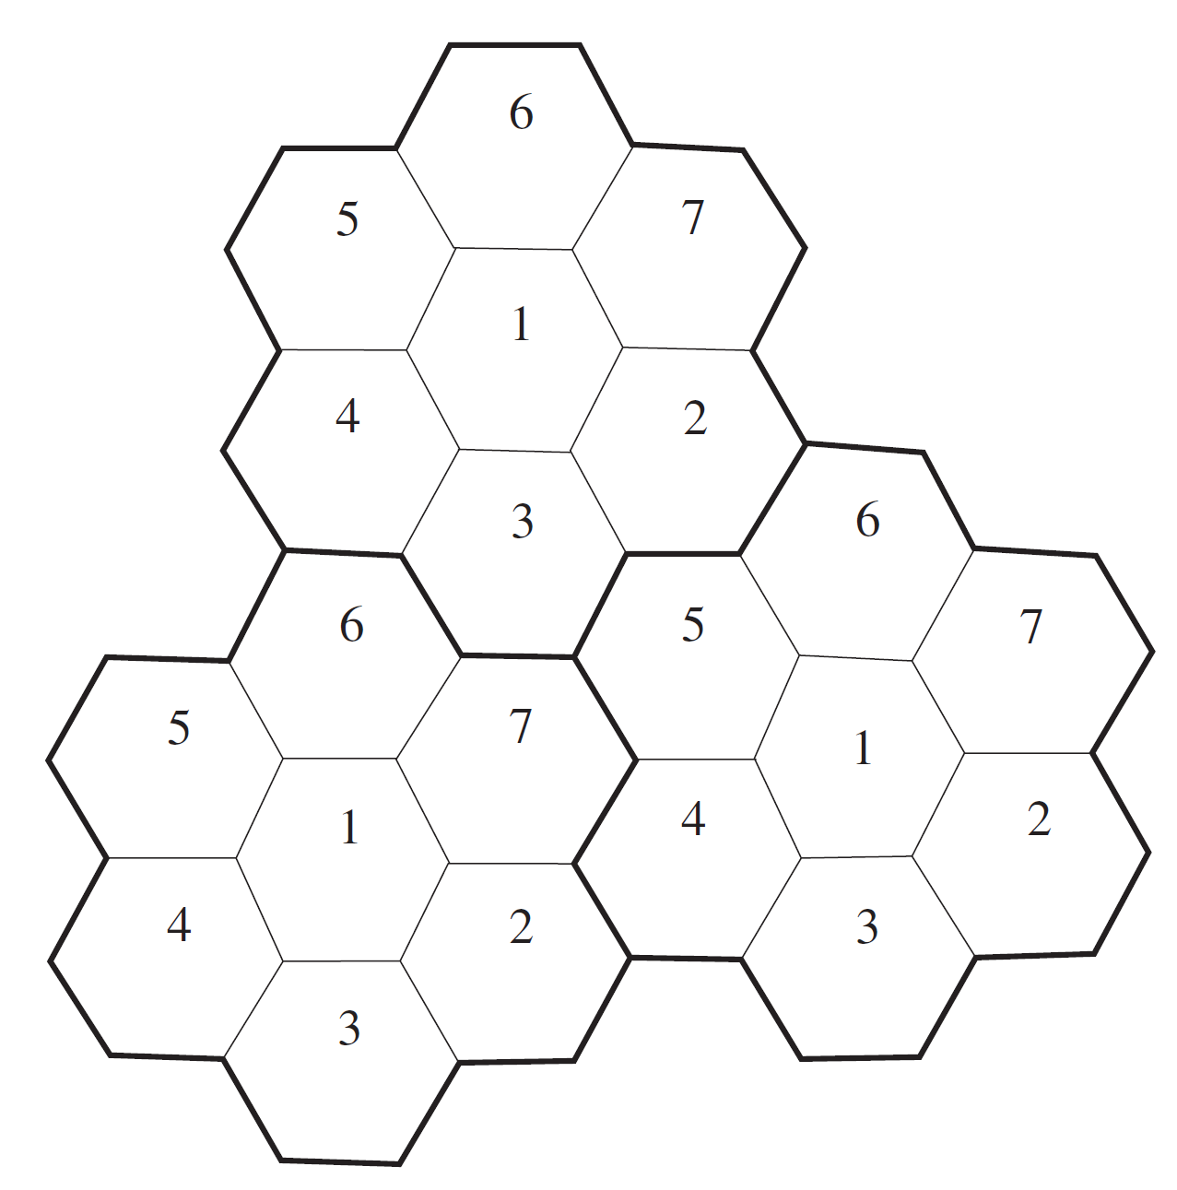
CELLULAR CONCEPT

Slide 6
Summary: Characteristics of Cellular and Cordless Low-Tier PCS Technologies
30

Slide 7
Evolution

Slide 8
GPRS- Introduction
General Packet Radio Service (GPRS) is a 2.5 generation packet based network technology for GSM networks.
A GSM based packet switched technology, enables connections based on Internet Protocols.
The data is divided into packets and is then transferred via the radio and core network.
Facilitates instant connections whereby information can be sent or received immediately.
Enable Internet applications, from web browsing to chat, location based applications(GPS,MAP), e-commerce etc over the mobile network.
Other new applications for GPRS, include file transfer and the ability to remotely access and control/monitor house appliances and machines.

Slide 9
GSM in World

Slide 10
GSM in India

Slide 11
Third-Generation CDMA Systems –few examples
DoCoMo W-CDMA field trial
Lucent cdma2000 system
Nortel W-CDMA trial system
Ericsson W-CDMA trial system
Motorola cdma2000 trial system

Slide 12
CDMA base transceiver station
7

Slide 13
CDMA base station controller
8

Slide 14
Mobile switching center
10

Slide 15
GSM Operation
Speech
Speech
Speech coding
Speech decoding
13 Kbps
Channel Coding
Channel decoding
22.8 Kbps
Interleaving
De-interleaving
22.8 Kbps
Burst Formatting
Burst Formatting
33.6 Kbps
Ciphering
De-ciphering
33.6 Kbps
Radio Interface
Modulation
Demodulation
270.83 Kbps

Slide 16
GSM Specifications-1
RF Spectrum
GSM 900
Mobile to BTS (uplink): 890-915 Mhz
BTS to Mobile(downlink):935-960 Mhz
Bandwidth : 2* 25 Mhz
GSM 1800
Mobile to BTS (uplink): 1710-1785 Mhz
BTS to Mobile(downlink) 1805-1880 Mhz
Bandwidth : 2* 75 Mhz

Slide 17
GSM Specification-II
Carrier Separation : 200 Khz
Duplex Distance : 45 Mhz
No. of RF carriers : 124
Access Method : TDMA/FDMA
Modulation Method : GMSK
Modulation data rate : 270.833 Kbps

Slide 18
GSM Applications
Mobile telephony
GSM-R
Telemetry System
- Fleet management
- Automatic meter reading
- Toll Collection
- Remote control and fault reporting of DG sets
Value Added Services

Slide 19
Features Of GSM
2nd Generation
GSM -9.6 Kbps (data rate)
2.5 Generation ( Future of GSM)
HSCSD (High Speed ckt Switched data)
Data rate : 76.8 Kbps (9.6 x 8 kbps)
GPRS (General Packet Radio service)
Data rate: 14.4 - 115.2 Kbps
EDGE (Enhanced data rate for GSM Evolution)
Data rate: 547.2 Kbps (max)
3 Generation
WCDMA(Wide band CDMA)
Data rate : 0.348 – 2.0 Mbps

Slide 20
Bearer Services
Include various data services for information transfer between GSM and other networks like PSTN, ISDN etc at rates from 300 to 9600 bps
Short Message Service (SMS)
up to 160 character alphanumeric data transmission to/from the mobile terminal
Unified Messaging Services(UMS)
Group 3 fax
Voice mailbox
Electronic mail

Slide 21
Supplementary Services
Call related services :
Call Waiting- Notification of an incoming call while on the handset
Call Hold- Put a caller on hold to take another call
Call Barring- All calls, outgoing calls, or incoming calls
Call Forwarding- Calls can be sent to various numbers defined by the user
Multi Party Call Conferencing - Link multiple calls together
CLIP – Caller line identification presentation
CLIR – Caller line identification restriction
CUG – Closed user group

Slide 22
GSM System Architecture
PSTN
ISDN
PDN
BSC
MS
BTS
MSC
GMSC
BTS
BSC
VLR
MS
BTS
EIR
AUC
MS
HLR

Slide 23
GSM System Architecture-I
Mobile Station (MS)
Mobile Equipment (ME)
Subscriber Identity Module (SIM)
Base Station Subsystem (BSS)
Base Transceiver Station (BTS)
Base Station Controller (BSC)
Network Switching Subsystem(NSS)
Mobile Switching Center (MSC)
Home Location Register (HLR)
Visitor Location Register (VLR)
Authentication Center (AUC)
Equipment Identity Register (EIR)

Slide 24
System Architecture Mobile Station (MS)
The Mobile Station is made up of two entities:
Mobile Equipment (ME)
2. Subscriber Identity Module (SIM)

Slide 25
System Architecture Mobile Station (MS)
Mobile Equipment
Portable,vehicle mounted, hand held device
Uniquely identified by an IMEI (International Mobile Equipment Identity)
Voice and data transmission
Monitoring power and signal quality of surrounding cells for optimum handover
Power level : 0.8W – 20 W
160 character long SMS.

Slide 26
System Architecture Mobile Station (MS) contd.
Subscriber Identity Module (SIM)
Smart card contains the International Mobile Subscriber Identity (IMSI)
Allows user to send and receive calls and receive other subscribed services
Encoded network identification details
- Key Ki,Kc and A3,A5 and A8 algorithms
Protected by a password or PIN
Can be moved from phone to phone – contains key information to activate the phone

Slide 27
System Architecture Base Station Subsystem (BSS)
Base Station Subsystem is composed of two parts that communicate across the standardized Abis interface allowing operation between components made by different suppliers
Base Transceiver Station (BTS)
Base Station Controller (BSC)

Slide 28
System Architecture Base Station Subsystem (BSS)
Base Transceiver Station (BTS):
Encodes,encrypts,multiplexes,modulates and feeds the RF signals to the antenna.
Frequency hopping
Communicates with Mobile station and BSC
Consists of Transceivers (TRX) units

Slide 29
System Architecture Base Station Subsystem (BSS)
Base Station Controller (BSC)
Manages Radio resources for BTS
Assigns Frequency and time slots for all MS’s in its area
Handles call set up
Transcoding and rate adaptation functionality
Handover for each MS
Radio Power control
It communicates with MSC and BTS

Slide 30
System Architecture Network Switching Subsystem(NSS)
Mobile Switching Center (MSC)
Heart of the network
Manages communication between GSM and other networks
Call setup function and basic switching
Call routing
Billing information and collection
Mobility management
- Registration
- Location Updating
- Inter BSS and inter MSC call handoff
MSC does gateway function while its customer roams to other network by using HLR/VLR.

Slide 31
System Architecture Network Switching Subsystem
Home Location Registers (HLR)
- permanent database about mobile subscribers in a large service area(generally one per GSM network operator)
database contains IMSI,MSISDN,prepaid/postpaid,roaming restrictions,supplementary services.
Visitor Location Registers (VLR)
Temporary database which updates whenever new MS enters its area, by HLR database
Controls those mobiles roaming in its area
Reduces number of queries to HLR
Database contains IMSI,TMSI,MSISDN,MSRN,Location Area,authentication key

Slide 32
System Architecture Network Switching Subsystem
Authentication Center (AUC)
Protects against intruders in air interface
Maintains authentication keys and algorithms and provides security triplets ( RAND,SRES,Kc)
Generally associated with HLR
Equipment Identity Register (EIR)
- Database that is used to track handsets using the IMEI (International Mobile Equipment Identity)
Made up of three sub-classes: The White List, The Black List and the Gray List
Only one EIR per PLMN

