Slide 1
Satellite Communication

Slide 2
Important Milestones (before 1950)
Putting the concepts together
1600 Tycho Brache’s experimental observations on planetary motion.
1609-1619 Kepler’s laws on planetary motion
1926 First liquid propellant rocket lauched by R.H. Goddard in the US.
1927 First transatlantic radio link communication
1942 First successful launch of a V-2 rocket in Germany.
1945 Arthur Clarke publishes his ideas on geostationary satellites for worldwide communications (GEO concept).

Slide 3
Main orbit types:
GEO 36,000 km
MEO 5,000 – 15,000 km
LEO 500 -1000 km

Slide 4
Radio Frequency Spectrum Commonly Used Bands

Slide 5
Satellite System Elements
Space Segment
Satellite
Coverage Region
Earth Stations
SCC
TT&C Ground Station
Ground Segment

Slide 6
Satellite Subsystems
Communications
Antennas
Transponders
Common Subsystem (Bus Subsystem)
Telemetry/Command (TT&C)
Satellite Control (antenna pointing,attitude)
Propulsion
Electrical Power
Structure
Thermal Control

Slide 7
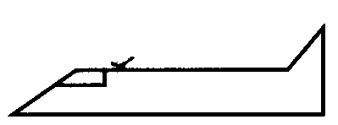
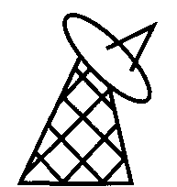
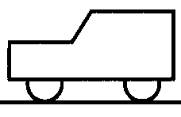
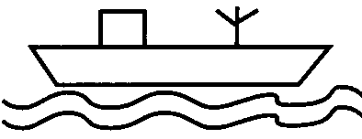
Ground Segment
Collection of facilities, users and applications.
FSS – Fixed Satellite Service
MSS – Mobile Satellite Service
Earth Station = Satellite Communication Station (air, ground or sea, fixed or mobile).

Slide 8
Basic Principles
Satellite
Uplink
Downlink
Earth Station
Earth Station
Tx
Source Information
Output Information
Rx

Slide 9
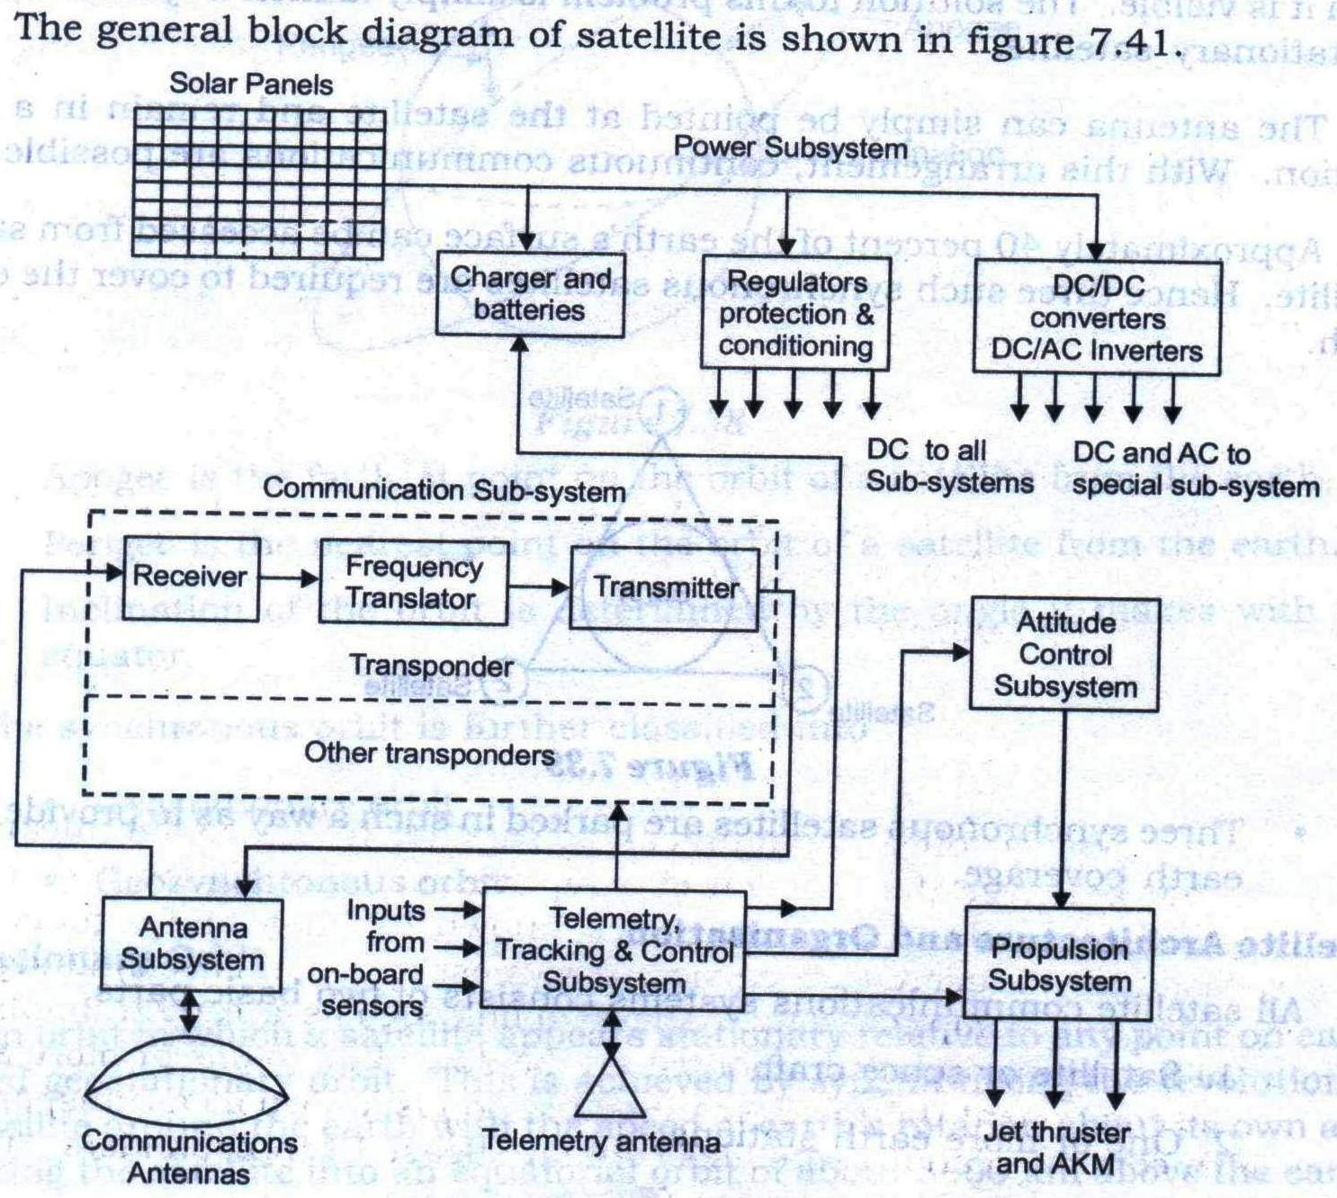

Slide 10
Digital Communication System
TRANSMITTER
Source Data
Source Coding
Channel Coding
Modulator
RF Channel
Output Data
Source Decoding
Channel Decoder
Demodulator
RECEIVER

